Slide 1
Software Testing

Slide 2
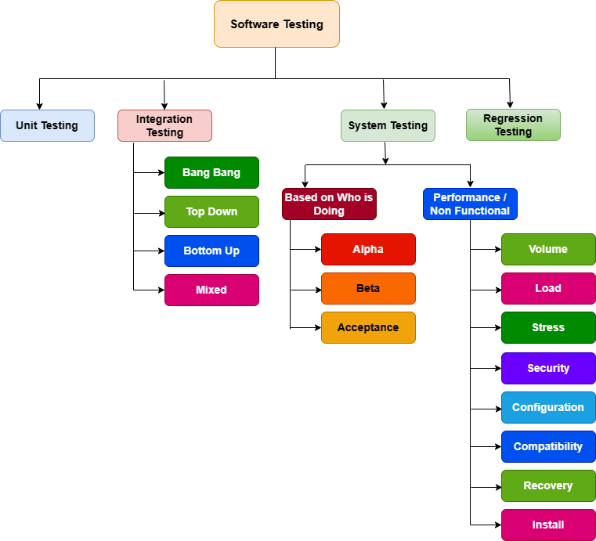

Slide 3
Unit Testing
Unit testing: Fundamental concept in software engineering
Involves testing individual components or units of code
Tested in isolation to ensure intended functionality
Crucial practice for bug identification and prevention
It is done by developers

Slide 4
Unit Testing
Unit Testing:
Definition: Unit testing is a testing technique where individual components or units of a software application are tested in isolation to ensure that they work correctly and produce the expected outcomes.
Example (LMS Context): Imagine you're building an LMS, and one of the components is the "User Authentication" module responsible for handling user logins. Unit testing of this module would involve testing it independently from the rest of the system.

Slide 5
Unit Testing
Explanation (LMS Example) :
User Authentication Component:
Let's say your LMS has a module that handles user authentication. It ensures that only authorized users can access the system. This module includes functions like "validateUserCredentials" and "generateAuthToken."

Slide 6
Unit Testing
Unit Testing Approach:
During unit testing, you isolate this "User Authentication" module from the rest of the LMS. You test each function within the module individually to make sure they work as intended.
Test Scenarios:
For the "validateUserCredentials" function, you create test cases with valid and invalid user credentials and check if the function correctly identifies whether the credentials are valid or not.
For the "generateAuthToken" function, you test whether it generates authentication tokens correctly and follows security protocols.

Slide 7
Unit Testing
Benefits:
Unit testing helps in above case to catch issues within the "User Authentication" module itself. If you find any bugs or unexpected behaviors, you can fix them before integrating the module into the larger LMS system.
Isolation:
The key point of unit testing is that you isolate the module being tested from other parts of the LMS. This isolation ensures that any issues discovered during testing are specific to that module and not influenced by interactions with other modules.
Confidence in Building:
Once you've verified that the "User Authentication" module works correctly through unit testing, you can confidently integrate it into the LMS knowing that this crucial component is reliable.

Slide 8
Integration Testing
Integration testing making sure the parts work together
It occurs after unit testing and before System testing.
Types of Integration Testing
Big-Bang
Mixed(Sandwich)
Top-Down
Bottom-Up

Slide 9
Integration Testing
Big-Bang Integration Testing:
Definition: Big-Bang integration testing involves combining all the individual components or modules of a system and testing them together as a whole.
Purpose: This approach quickly assembles the system for testing, but issues may be harder to pinpoint if they arise.
Example (LMS Context): In an LMS, imagine combining all the separate modules like user authentication, course enrollment, content delivery, and assessment tools. You'd then test the entire system together to see how well they work collectively.

Slide 10
Integration Testing
Top-Down Integration Testing:
Definition: Top-down integration testing begins by testing the higher-level modules first and gradually integrating lower-level modules.
Purpose: This approach checks the main functionalities early on but may postpone testing detailed components.
Example (LMS Context): Start by testing essential LMS features like user authentication and course enrollment. After ensuring they work together, you add more details like content delivery and assessment. Think of it as building a pyramid, where you establish the base functionality first before adding the finer components.

Slide 11
Integration Testing
Bottom-Up Integration Testing:
Definition: Bottom-up integration testing starts with testing individual modules or components and then gradually integrates them into larger parts of the system.
Purpose: This approach validates the detailed functionalities first and progressively builds up to testing the complete system.
Example (LMS Context): Begin with individual components, such as content delivery and assessment tools. Once you verify that they function correctly, you integrate them into broader functionalities like course management and user authentication. It's like constructing a tower by stacking one block upon another.

Slide 12
Integration Testing
Mixed (Sandwich) Integration Testing:
Definition: Mixed integration testing combines top-down and bottom-up approaches, testing specific modules or layers together while keeping others isolated.
Purpose: This approach balances between testing the whole system and addressing potential issues step by step.
Example (LMS Context): For the LMS, you might start by integrating and testing the core components, such as user authentication and course management (top-down). Then, you integrate and test the detailed functionalities like content delivery and assessment (bottom-up). It's like building layers of a sandwich, where you test and combine various layers individually before putting them all together.

Slide 13
System Testing
Alpha Testing
Beta Testing
Acceptance Testing

Slide 14
System Testing
Alpha Testing:
Definition: Alpha testing is the initial phase of testing where a software application is tested by the internal development team in a controlled environment.
Purpose: The goal of alpha testing is to identify and fix any major issues, bugs, or design flaws before the software is released for wider testing.
Example (LMS Context - Alpha Testing): Imagine the development team of an LMS is working on a new feature that allows students to collaborate on projects. In alpha testing, the developers themselves would use the feature extensively. They would check if it works as expected, whether there are any major glitches, and if it aligns with the design and functionality goals.

Slide 15
System Testing
Beta Testing:
Definition: Beta testing occurs after alpha testing and involves a limited group of external users or customers trying out the software in a real-world environment.
Purpose: Beta testing gathers user feedback, identifies usability issues, and uncovers potential bugs that might not have been caught during internal testing.
Example (LMS Context - Beta Testing): In the LMS scenario, beta testing could involve inviting a group of students and teachers who are willing to try out the new collaborative feature. They would provide feedback on their experiences using the feature, whether they find it useful, and report any issues they encounter, such as difficulties in accessing or using the collaboration tools.

Slide 16
System Testing
Acceptance Testing:
Definition: Acceptance testing is the final phase of testing where a software application is evaluated against specified requirements to determine whether it's ready for release.
Purpose: Acceptance testing ensures that the software meets the expectations of the intended users and stakeholders.
Example (LMS Context - Acceptance Testing): Imagine a university has decided to adopt the new LMS version with the collaborative feature. The university's administrators and teaching staff would perform acceptance testing. They would validate that the feature aligns with their requirements, such as ease of use, security, and integration with existing workflows. Once the feature passes this testing and meets their needs, it's ready for deployment to all users.

Slide 17
System Testing
Performance Testing :
Definition: Performance testing evaluates how well a system meets speed, responsiveness, and stability criteria under varying conditions.
Example (LMS Context): In an LMS, performance testing involves checking how quickly course materials load, how fast users can access different sections of the platform, and how well the system responds to different levels of user activity.

Slide 18
System Testing
Volume Testing:
Definition: Volume testing checks how well a system handles a large amount of data, transactions, or users.
Example (LMS Context): In the LMS scenario, volume testing would involve simulating a situation where a large number of students simultaneously access course content, submit assignments, and participate in discussions to ensure the system can maintain responsiveness.

Slide 19
System Testing
Load Testing:
Definition: Load testing assesses how well a system performs under expected load conditions.
Example (LMS Context): Load testing an LMS entails simulating a standard number of students accessing the system, viewing lectures, taking quizzes, and submitting assignments to ensure the platform remains efficient and responsive.

Slide 20
System Testing
Stress Testing:
Definition: Stress testing evaluates how a system behaves under extreme conditions or heavy loads.
Example (LMS Context): Stress testing an LMS might involve pushing the system to its limits by simulating a sudden influx of users and activities, such as many students joining a live video lecture simultaneously, to see how well it manages the increased demand.

Slide 21
System Testing
Security Testing:
Definition: Security testing identifies vulnerabilities and ensures the protection of data and user privacy.
Example (LMS Context): Security testing in an LMS involves checking for secure user authentication, encrypted data transmission, and protection against unauthorized access to sensitive student information.

Slide 22
System Testing
Configuration Testing:
Definition: Configuration testing verifies system behavior under different settings or configurations.
Example (LMS Context): Configuration testing for an LMS could involve testing how the system handles different grading schemes, course access rules, or notification settings across various courses.

Slide 23
System Testing
Compatibility Testing:
Definition: Compatibility testing checks system functionality across different devices, browsers, and platforms.
Example (LMS Context): Compatibility testing for an LMS ensures that course content, assignments, and features work seamlessly on various devices such as computers, tablets, and smartphones, using different browsers and operating systems.

Slide 24
System Testing
Recovery Testing:
Definition: Recovery testing evaluates system recovery from failures or disruptions.
Example (LMS Context): Recovery testing in an LMS might involve deliberately causing a server crash and then observing how quickly the system recovers and restores normal operations without data loss.

Slide 25
System Testing
Installation Testing:
Definition: Installation testing ensures the system can be correctly installed and configured across different environments.
Example (LMS Context): Installation testing in an LMS involves verifying that the software can be smoothly installed on various platforms, such as cloud servers or local machines, and that it operates properly after installation

Slide 26
System Testing
White-Box Testing:
Definition: White-box testing involves examining the internal structure, code, and logic of a system to ensure its correctness and completeness.
Purpose: White-box testing helps uncover code-related issues, such as logical errors and improper implementation.
Example (LMS Context): In white-box testing for an LMS, a tester with knowledge of programming might review the actual code that handles user authentication. They would analyze how the authentication process works within the code, looking for any vulnerabilities or potential security gaps.

Slide 27
System Testing
Black-Box Testing:
Definition: Black-box testing focuses on testing the functionality of a system without knowledge of its internal structure or implementation.
Purpose: Black-box testing evaluates the system from the perspective of a user and aims to ensure that it meets functional requirements and behaves as expected.
Example (LMS Context): In black-box testing of an LMS, a tester would interact with the system as a user, logging in, accessing course materials, submitting assignments, and taking quizzes. They would validate that the system performs these actions correctly and delivers the expected outcomes without needing to know the underlying code.

Slide 28
System Testing
Grey-Box Testing:
Definition: Grey-box testing combines aspects of both white-box and black-box testing. Testers have partial knowledge of the system's internal workings.
Purpose: Grey-box testing seeks to balance the advantages of both approaches, addressing functional issues while considering the system's internal logic.
Example (LMS Context): In grey-box testing for an LMS, a tester might have limited knowledge of the system's database structure. They could focus on testing functionalities like user enrollment and withdrawal, where a balance of understanding how data is stored (white-box) and assessing user interactions (black-box) is required.

Slide 29
Regression Testing
Regression Testing:
Definition: Regression testing is the process of retesting a software system after making changes to ensure that existing functionalities remain unaffected by those changes.
Purpose: Regression testing helps identify unintended side effects and potential bugs that might have been introduced by recent modifications.

Slide 30
Regression Testing
Full Regression Testing:
Definition: Full regression testing involves testing the entire software application to ensure all functionalities work as expected after changes.
Purpose: Full regression testing provides a comprehensive view of the system's behavior after modifications, minimizing the risk of overlooking issues.
Example (LMS Context): Suppose you've made changes to the user interface, added new features, and updated some existing functions of the LMS. Performing full regression testing means thoroughly testing every aspect of the LMS, from user authentication and course enrollment to content delivery and assessment, to ensure that no unexpected issues have arisen due to the changes.

Slide 31
Regression Testing
Partial Regression Testing:
Definition: Partial regression testing focuses on testing specific areas or functionalities of the software that are directly affected by the changes.
Purpose: Partial regression testing is more targeted and efficient, especially when changes are localized to specific parts of the system.
Example (LMS Context): If you've made changes to the grade calculation algorithm in your LMS, you might opt for partial regression testing. In this case, you would specifically test functionalities related to grading, such as assigning grades to assignments and displaying them to students, to ensure that the changes haven't caused any unintended issues in these areas.

